Slide 1
Effect of Delayed Transportation of Blood Samples on Serum Bilirubin values in Neonates
Malays J Med Sci. 2010 Jul-Sep;17(3):27-31
Authors: Poovendran Saththasivam, Kirtanaa Voralu, Noraida Ramli,
Mohd Rafi Mustapha, Julia Omar, Hans Van Rostenberghe
Dr. Sakhina Khatun
Professor, Department of Biochemistry
Sylhet Women’s Medical College

Slide 2
Abstract
Background
Delays in transprting blood samples – may result in inaccurate S.Bil
Samples may be exposed to light or hemolysis during delays
This study was done to evaluate the effects of delay on S.Bil results.
Methods
Samples taken from admitted neonates with jaundice
Blood was taken in 3 labelled containers-- 0, 1 and 3 hrs.
Bilirubin was measured colourimetrically.

Slide 3
Abstract
Results
Total 36 serum samples were studied.
There was significant differences in mean indirect bilirubin
between 1 h & 3 h samples compared with ‘0’ hr samples.
There were no significant differences of total or direct bilirubinmeasured at different time intervals.
Conclusion
Delayed testing influence the bilirubin test results
Key Words
Bilirubin, Neonatal jaundice, Transportation,
Time factors, Specimen handling

Slide 4
Introduction
Test result may be altered for delay in transport of blood to laboratory.
Serum bilirubin level demands special attention for altered result.
Unconjugated bilirubin is sensitive for alteration if test is delayed.
Effect of delays on actual S.Bil levels have not been studied.

Slide 5
Introduction
Accurate S.Bil. level is especially important for neonatal jaundice
since S.bilirubin level often dictates the treatment decision
Inaccurate testing may cause undertreatment or overtreatment
If transportation delay decreases S.bil.– a large trial is needed to generate a formula for correction factor for delayed testing.
This study aimed to determine the effects of delay in transportation of blood samples on s.bil. values in neonates

Slide 6
Materials & Methods
Place of study
Neonatal Intensive Care Unit(NICU) and Special Care Nursery(SCN)
at Hospital University Sains Malaysia(HUSM)
Duration of study
From May 2007 to July 2007.
Inclusion criteria
Neonates with jaundice were included
Ethical consideration
Written informed consent taken from parents or guardians.

Slide 7
Materials & Methods
Blood sample of each neonate was collected through venepuncture
Each blood sample was taken in 3 separate containers, ‘A’, ‘B’, ‘C’
Container ‘A’ was sent immediately, ‘B’ & ‘C’- after 1 & 3 h delays.
A dedicated person ensured timely transport & test
Each neonate was subjected to only one blood sample in the study.

Slide 8
Materials & Methods
Total & Direct bilirubin were measured by colorimetric method
Indirect Bilirubin was calculated from the diff. of total & direct bil.
Sample size was calculated using –
sample size calculation PS software(Version 2, 2003).
A sample size of 36 neonates was taken, to achieve a power of 80%
with a significance level of 0.05%.

Slide 9
Materials & Methods
Data analysis were performed using SPSS version 11.0
(SPSS Inc, Chicago,IL)
Mean& SD for each delay interval were calculated
Difference in Total, Direct& Indirect bilirubin between – 0 &1 h,
as well as 0 & 3 h intervals were determined by paired ’t’ test.
The study was approved by Ethical committee of Universiti Sains Malaysia, Kubang Kerian where the research was done.

Slide 10
Results
Total 36 samples were studied.
All samples reached the laboratory within 5 min of the plan.
Mean and SD for Total, Direct & Indirect bilirubin at different time
are presented in Tables 1,2& 3 respectively
There was a significant difference in Indirect bilirubin levels of
1-h & 3-h samples compared with 0-h samples.
There were no statistically significant differences observed in
Total & Direct bilirubin measured at different delay intervals.

Slide 12
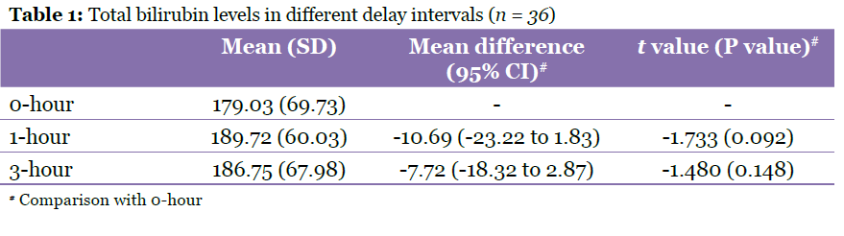

Slide 13
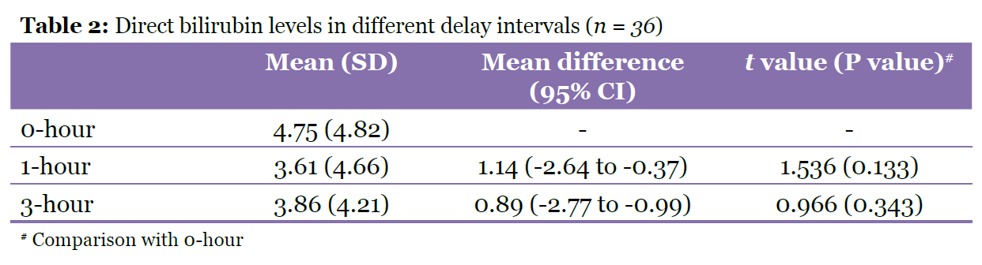

Slide 15
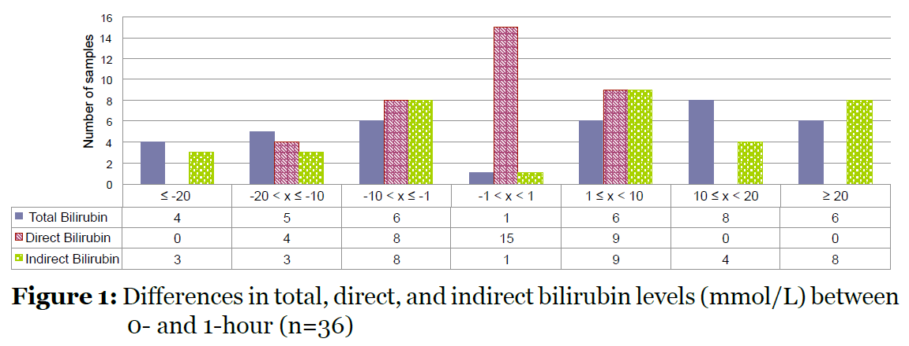

Slide 17
Results
17% results of 1- h delay samples & 14% results of 3-h delay samples were very similar
38% results after 1-h delay & 32% results after 3-h delay showed decreased values compared with non-delayed values.
45% results after 1-h delay & 54% results after 3-h delay showed increased values.

Slide 18
Discussion
This is the first study to determine effect of delay on bilirubin result
No major effect on treatment plan for some patients, espec ially deciding the need for phototheraphy.
For some patients the result was significant different for delayed testing
Indirect bilirubin showed marked variation .

Slide 19
Discussion
Increase in bilirubin after a delay– could be due to hemolysis,
before sample processing.
Decreased bilirubin could be explained by breakdown of bilirubin,
due to light exposure.
Development of formula to adjust for delays is not feasible due to
erratic differences in bilirubin level.

Slide 20
Conclusion
The was no consistent trend towards the increase or decreased S.Bil in delayed testing
However, in a substantial number of cases, decision to start or discontinue phototheraphy could be altered due to erroneous test results that may be caused by delayed testing

Slide 21
Acknowledgments
Thanks
For cooperation and support to:
The staffs at the NICU, HUSM,
Research & Ethical Committee
Director of HUSM
For financial support to:
Malaysian Paediatric Foundation

Slide 22
